Slide 1

WALMART SALES DATA - QUICK INSIGHT
BY Fousiya Mundam PALLATH
Tools USED:
PYTHON : https://github.com/mpfouziya/Walmart-Sales-Forecasting/blob/main/Walmart_Sales_Prediction.ipynb
MICROSTRATEGY : https://github.com/mpfouziya/Walmart-Sales-Forecasting/blob/main/Walmart%20Sales%20Forecasting.mstr

Slide 2
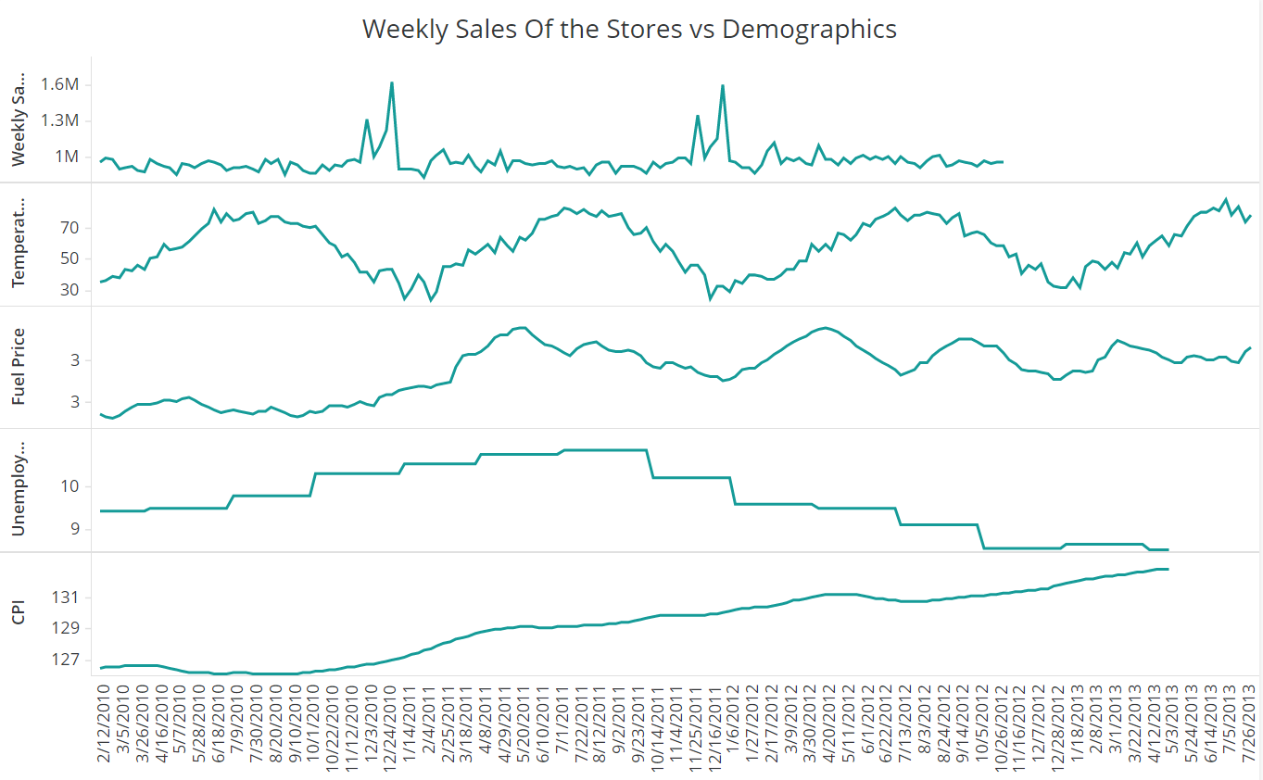
Weekly Sales & Demographics
Graph clearly shows that there is a yearly cycles happening for the sales across the stores. The data shown is for the store 34 (Type A). Same kind of cases are seen for majority of the stores in Type A, B and C. We can thus see a correlation with the temperature as well.
Other features like fuel price, CPI and Unemployment is not correlated with the Seasonality of the sales data. But the sales figures are affected by these features.

Slide 3
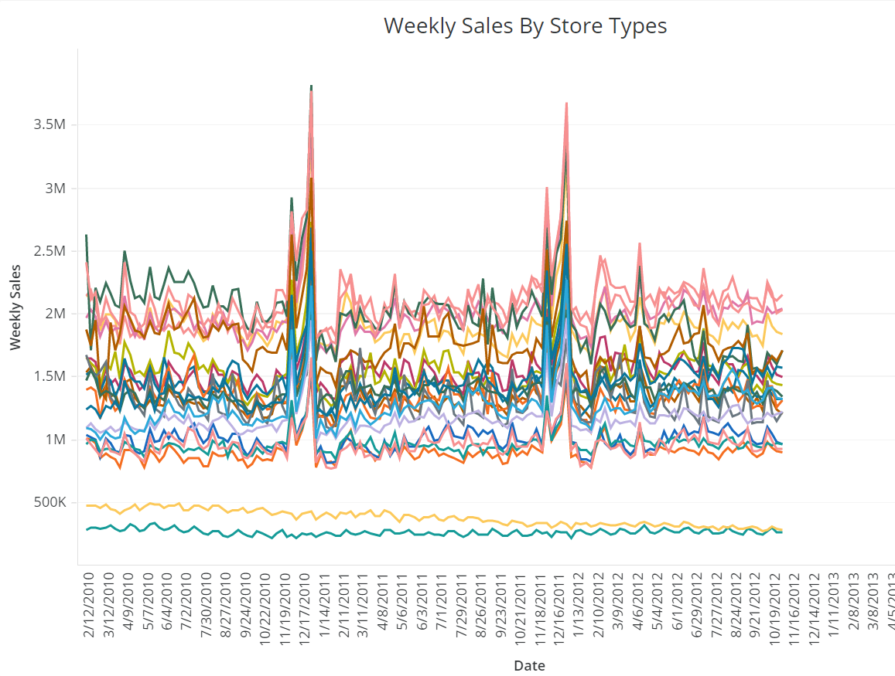
Weekly Sales by Store Types
The graph shows the weekly sales for different stores of store type A.
The sales shown by the 2 stores at the bottom depicts a clear monthly seasonality and less weekly sales compared to the other stores. These stores are of less size (39,690 and 39,910) compared to the other stores of Type A. Same kind of cases are seen for most of the stores of Type B and Type C.
So it is clear that the yearly spikes, in weekly sales, are shown by the stores which are bigger in size. Lets see, whether these spikes are due to some other reason.

Slide 4
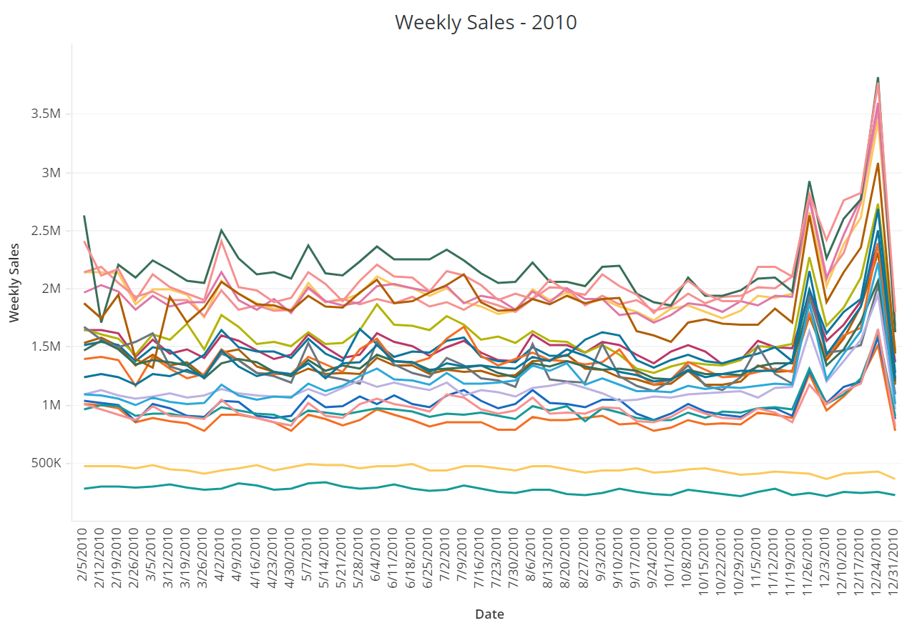
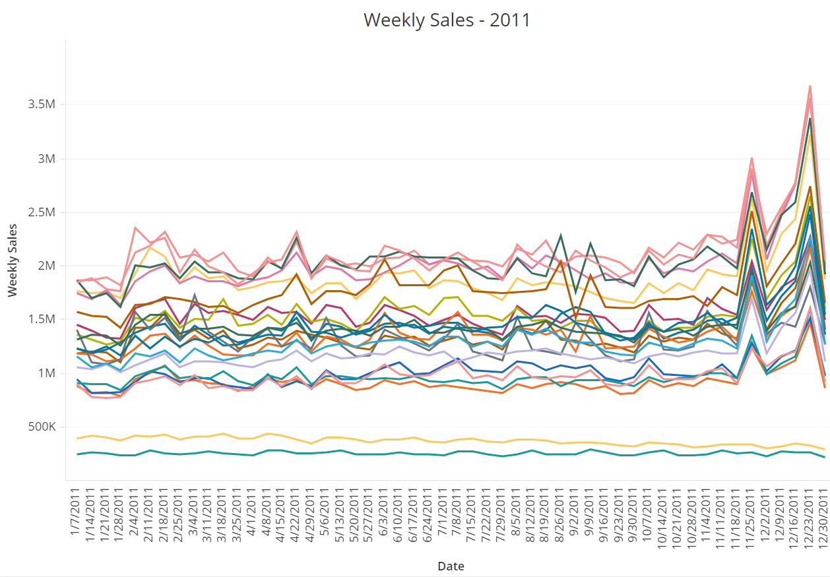
Weekly Sales & Holidays
The below graphs shows the weekly sales for the year 2010 and 2011 respectively for the Type A stores. And it is clear that the sales is high for the months of November and December (around the dates of Thanksgiving and Christmas Holidays). Same kind of pattern was shown for Type B as well.
Thanksgiving:26-Nov-10, 25-Nov-11, 23-Nov-12, 29-Nov-13 Christmas: 31-Dec-10, 30-Dec-11, 28-Dec-12, 27-Dec-13

Slide 5
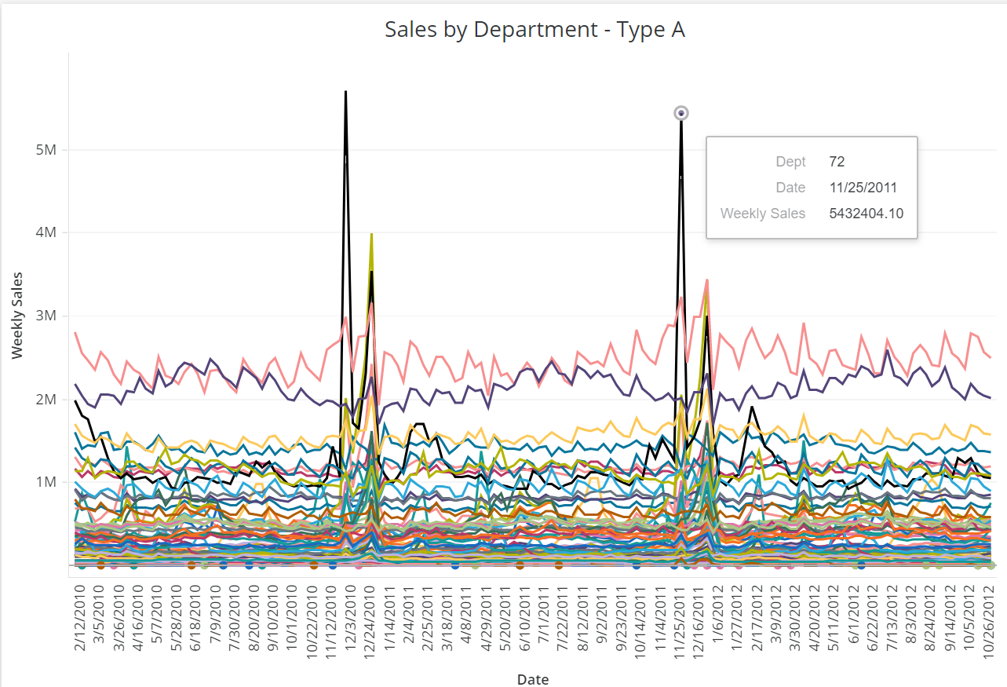
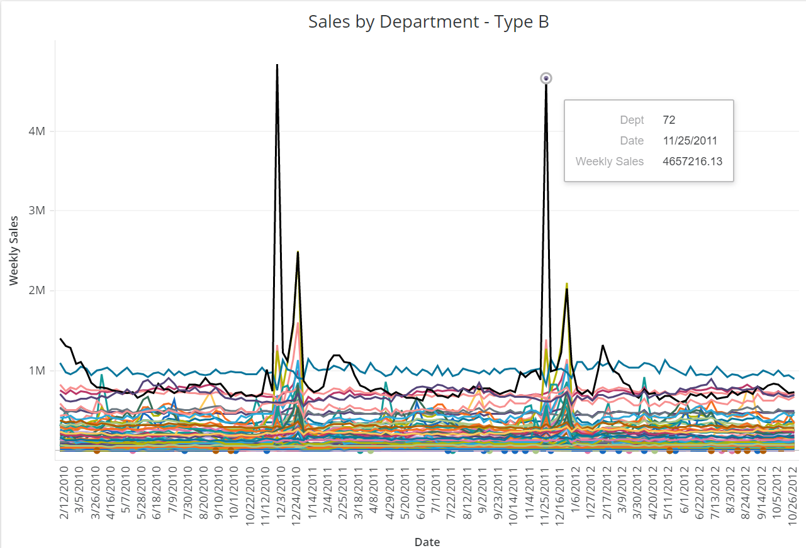
Sales by Department
Below graphs show the weekly sales by department of different store types. We can see that during the holidays we discussed in previous slide, the sales is more for department 72 for Type A & B. Also same kind of pattern, when comparing Type A and B, is seen for Dept.72 across the year. So we can say that the spike in sales at different stores during holidays is majorly from Dept.72 (then from Dept. 7). But Type C is not showing such a pattern.

Slide 6
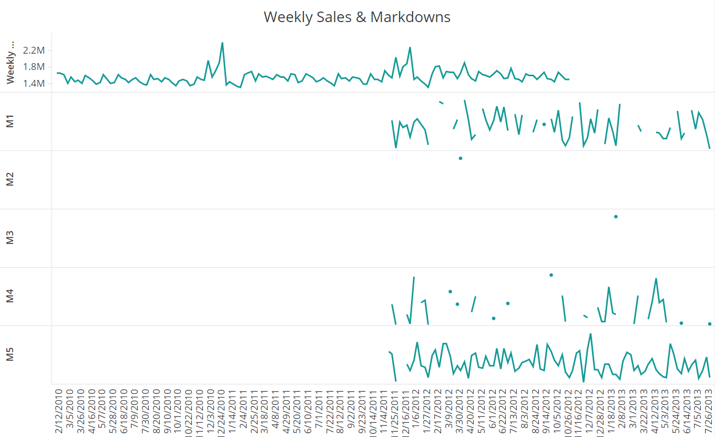
Markdowns
Markdowns are anonymous features, that depicts the discounts provided at different Walmart stores. The data is having many null values. Even though discounts results in more revenue, from the data it is clear that the markdowns are sometimes causing a drop in the revenue.
Graph : Weekly Sales & Markdown for Store1.
As the Markdown data is given starting from November 2011, the data is insufficient to make fruitful inferences about store sales.

Slide 7
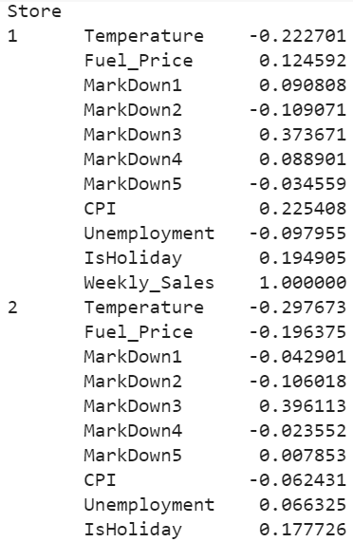
Correlation of features to the Weekly Sales
The table shows the correlation of different features to the weekly sales of different stores. Even though MarkDown data have many null values, MarkDown3 is showing higher correlation to the Weekly_Sales (of the 45 stores), compared to other features.

Slide 8
THANK YOU

